Slide 1

HAND CRICKET
SRM INSTITUTE OF SCIENCE AND TECHNOLOGY
FACULTY OF ENGINEERING AND TECHNOLOGY
DEPARTMENT OF NETWORKING AND COMMUNICATIONS
18CSC101J- MINI PROJECT
Shashwat Prasad Sarthak Dwivedi Roshan Priyadarshi
(RA2111026010143) (RA2111026010122) (RA2111026010139)
Branch – Computer Science Engineering with Specialization in Artificial Intelligence & Machine Learning
Section – T1
Instructor name – Sindhuja M

Slide 2
Table of contents
Introduction
Objectives
System Specification
Algorithm
Flowchart
Source Code
Results and Explanation
References
Compiler Used

Slide 3
Introduction

Slide 4
Introduction
As we all know that all children have hobby to play cricket, but due to increasing infrastructure free lands are converted into complexes, due to which there is no free space left for children to play. We basically designed this program for those children who have love for cricket.

Slide 5
Objective

Slide 6
Objective
Objective
Due to busy world, no one is free to play together. Everyone is just busy with their works. So, we basically designed this application for those people who feels lonely. They can enjoy their moments if no one was there.
Here person can play unlimited matches in which there is no limit in balls. So, that can build interest in playing the game.

Slide 7
System Specification

Slide 8
System Specification
Operating System – Window / IOS
Processor – Intel core i7 / M1 chip
RAM – 8 / 16 GB
ROM – 1 TB (SSD)

Slide 9
Algorithm

Slide 10
Algorithm
Step – 1 : Start
Step – 2 : Enter Player Name
Step – 3 : Select Heads or Tails
Step – 4 : Generate a Random Number
Step – 5 : If Enter = Random Outcome
You won the toss
else
Bot won the toss
Step – 6 : Now user / Bot will select Batting / Bowling
Step – 7 : Enter a Number
Step – 8 : If Enter Number = Random Outcome
Display Out
else
Goto step 7
Step – 9 : In 2nd Innings, goto step 7
Step – 10 : If Target > 2nd innings runs
Display 1st innings batman's team won the match
else if Target = 2nd innings runs
Display Match Tie
else
Display 2nd innings batman’s team won the match
Step – 11 : End

Slide 11
Flowchart

Slide 12
Flowchart
Flowchart
Start
Select Heads/Tails
User Won
Bot Won
Batting
Batting
Bowling
Batting
Bowling
Bowling
Batting
Bowling
Batting
Display Winner
End

Slide 13
Source Code

Slide 14
Source Code
#include<stdio.h>
#include<stdlib.h>
#include<time.h>
void batting_player();
void bowling_player();
void end();
void game();
void play_again();
int main()
{
system("COLOR E4");
game();
}
void game()
{
printf("\n\n\n");
printf(" -----------------------------------\n");
printf(" Welcome to the Game of Hand cricket\n\n");
printf(" Powered by FAANG\n");
printf(" -----------------------------------\n");

Slide 15
Source Code
if(toss==choice_toss)
{
printf("\n You won the toss\n\n");
int choice_bat_ball;
printf(" Choose batting or bowling (1-Batting Or 2-Bowling) - ");
scanf("%d",&choice_bat_ball);
if(choice_bat_ball==1)
batting_player();
else
bowling_player();
}
else
{
int bot_choice,lower=1,upper=2;
printf("\n Bot won the toss\n\n");
srand(time(NULL));
bot_choice=(rand()%(upper-lower+1)+lower);
if(bot_choice==1)
{
printf(" Bot is batting");
bowling_player();
}

Slide 16
Source Code
else
{
printf(" Bot is bowling");
batting_player();
}
}
}
void batting_player()
{
printf("\n\n");
printf(" ------------\n");
printf(" First Inning\n");
printf(" ------------\n");
int score_1,total_1=0;
a:
printf("\n Enter The Run You Want To Score - ");
scanf("%d",&score_1);
int score_2,lower=0,upper=6;
srand(time(NULL));
score_2=(rand()%(upper-lower+1)+lower);
printf("\n Bot Threw - %d",score_2);

Slide 17
Source Code
if(score_1!=score_2)
{
total_1+=score_1;
printf("\n Total Runs Scored - %d",total_1);
printf("\n");
goto a;
}
else
{
printf("\n");
printf("\n Out");
printf("\n\n Target - %d",(total_1)+1);
printf("\n\n");
printf(" -------------\n");
printf(" Second Inning\n");
printf(" -------------\n");
int score_3,total_2=0;
b:
printf("\n Enter The Run You Want To Ball - ");
scanf("%d",&score_3);

Slide 18
Source Code
int score_4,lower=0,upper=6;
srand(time(NULL));
score_4=(rand()%(upper-lower+1)+lower);
printf("\n Run Scored By Bot - %d",score_4);
if(score_3!=score_4)
{
total_2+=score_4;
if(total_1>=total_2)
{
printf("\n Total Runs Scored - %d",total_2);
printf("\n");
goto b;
}
else
{
printf("\n");
printf("\n Bot Won The Match");
printf("\n");
play_again();
}
}

Slide 19
Source Code
else(score_3==score_4);
{
printf("\n");
printf("\n Bot is Out");
if(total_1>total_2)
{
printf("\n You Won The Match");
printf("\n");
play_again();
}
else if(total_1==total_2)
{
printf("\n Match is Tie");
printf("\n");
play_again();
}
else
{
printf("\n Bot Won The Match");
printf("\n");
play_again();
}

Slide 20
Source Code
}
}
}
void bowling_player()
{
printf("\n\n");
printf(" ------------\n");
printf(" First Inning\n");
printf(" ------------\n");
int score_1,total_1=0;
a:
printf("\n Enter The Run You Want To Ball - ");
scanf("%d",&score_1);
int score_2,lower=0,upper=6;
srand(time(NULL));
score_2=(rand()%(upper-lower+1)+lower);
printf("\n Run Scored By Bot - %d",score_2);
if(score_1!=score_2)
{
total_1+=score_2;
printf("\n Total Runs Scored - %d",total_1);
printf("\n");
goto a;

Slide 21
Source Code
}
else
{
printf("\n");
printf("\n Out");
printf("\n\n Target - %d",(total_1)+1);
printf("\n\n");
printf(" -------------\n");
printf(" Second Inning\n");
printf(" -------------\n");
int score_3,total_2=0;
b:
printf("\n Enter The Run You Want To Score - ");
scanf("%d",&score_3);
int score_4,lower=0,upper=6;
srand(time(NULL));
score_4=(rand()%(upper-lower+1)+lower);
printf("\n Bot Threw - %d",score_4);

Slide 22
Source Code
if(score_3!=score_4)
{
total_2+=score_3;
if(total_1>=total_2)
{
printf("\n Total Runs Scored - %d",total_2);
printf("\n");
goto b;
}
else
{
printf("\n");
printf("\n You Won The Match");
printf("\n");
play_again();
}
}
else(score_3==score_4);
{
printf("\n");
printf("\n Bot is Out");
}

Slide 23
Source Code
else if(total_1==total_2)
{
printf("\n Match is Tie");
printf("\n");
play_again();
}
else
{
printf("\n You Won The Match");
printf("\n");
play_again();
}
}
}
}
void play_again()
{
int choice_1;
printf("\n Do You Want To Play The Game Once More ? (1-Yes Or 2-No) - ");
scanf("%d",&choice_1);

Slide 24
Source Code
switch(choice_1)
{
case 1:
game();
break;
case 2:
end();
break;
}
}
void end()
{
printf("\n\n");
printf("\n -------------------------");
printf("\n Hope You Enjoyed The Game");
printf("\n Thank You");
printf("\n -------------------------");
printf("\n\n");
exit(1);
}

Slide 25
Results & Explanation

Slide 26
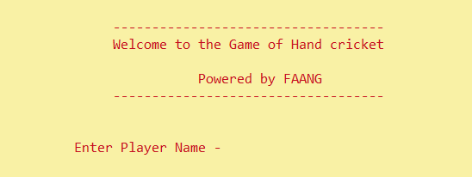
Results & Explanation
Colour used:
E4
Where E – Yellow (Background)
4 – Red (Text)
This will be your opening page
Where you have to enter the player name

Slide 27
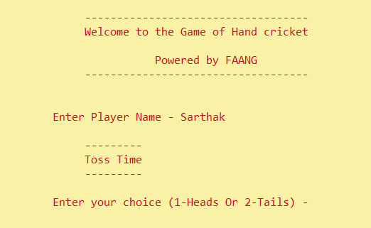
Results & Explanation
Just after entering the name
It will show toss time
In toss time
You have to choose 1 for Heads & 2 for Tails

Slide 28
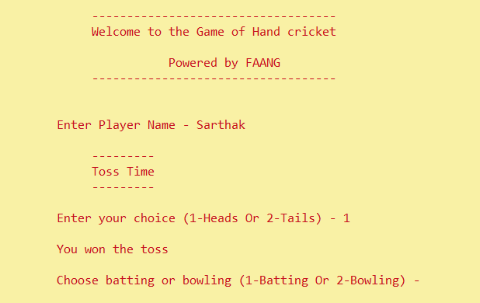
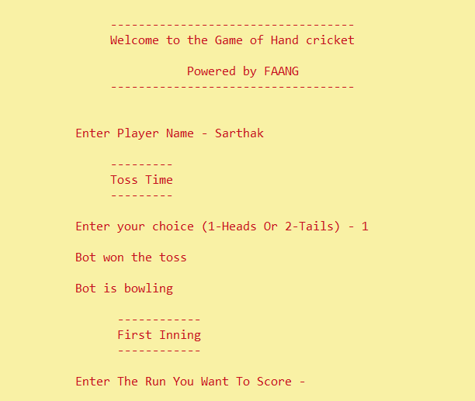
Results & Explanation
As you select your choose
By random function it will show any one option
If your option and random number is same then you won the toss and then you can choose whether to bat or ball
Else you loss the toss and bot will choose bat or bowl

Slide 29
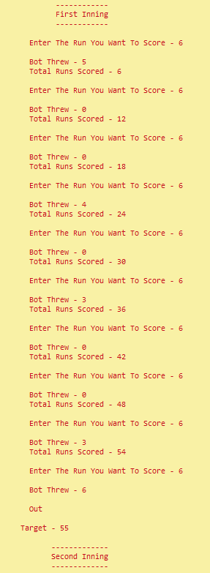
Results & Explanation
Results & Explanation
So let begin with first inning
Just any entering number it will count as run/ball threw to out
If number and random number are same then batsman will be out
Else innings go on
When the batsman will out it will automatedly show the target for second inning

Slide 30
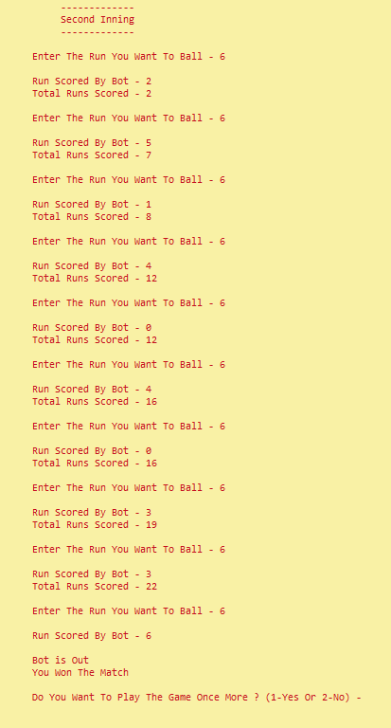
Results & Explanation
Now second inning begin
Again you have enter number
If enter number is same as random number innings end there
Else innings go on
If run scored in second inning is more than first inning then second inning player won the match
Else
First inning player won the match

Slide 31
Results & Explanation
After match is over
Application will ask whether to play again or not
If you enter 1 then game will start again
Else application will end

Slide 32
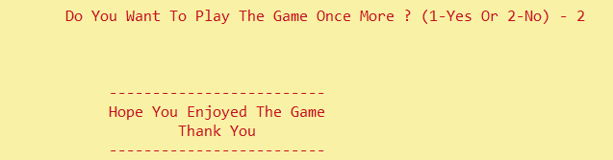
Results & Explanation
After entering 1
Game begin once again
After entering 1
Game begin once again
After entering 2
Application will end with sweet note

Slide 33
References
References
CodeChef
JavaTpoint
W3 School
Greekworld
Stack exchange
GeeksforGeeks

Slide 34
Compiler Used
VS Code
Code Blocks
Code Chef
GDB Online

Slide 35
Thanks

